Slide 1
INTRODUCTION-THEVENIN’S THEOREM
Dr. T.YUVAPRIYA
ASSISTANT PROFESSOR
SELECT

Slide 2
THEVENIN’S THEOREM
In many practical applications, it is always not necessary to analyse the complete circuit;
it requires that the voltage, current, or power in only one resistance of a circuit be found.
The use of this theorem provides a simple, equivalent circuit which can be substituted for the original network.

Slide 3
STATEMENT
Thevenin’s theorem states that any two terminal linear network having a number of voltage current sources and resistances can be replaced by a simple equivalent circuit consisting of a single voltage source in series with a resistance, where the value of the voltage source is equal to the open circuit voltage across the two terminals of the network, and resistance is equal to the equivalent resistance measured between the terminals with all the energy sources are replaced by their internal resistances.

Slide 4
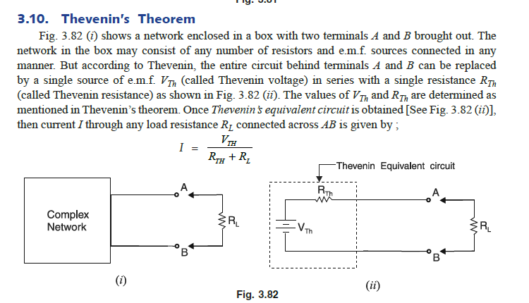

Slide 5
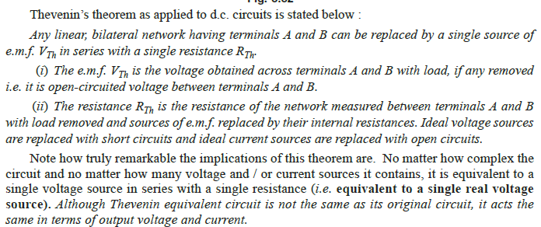

Slide 6
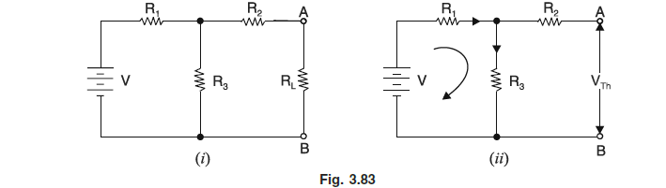

Slide 7
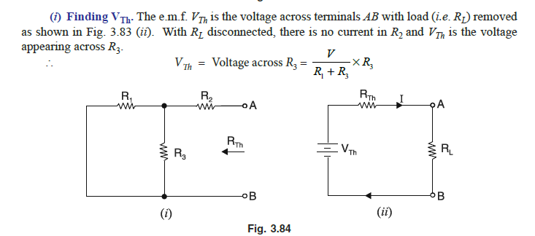

Slide 8
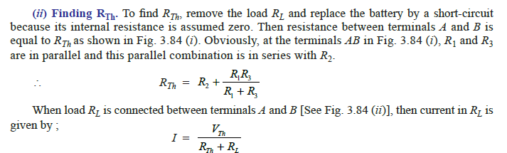

Slide 9
